Slide 1




What is your cloud strategy?
The Beauty and Joy of Computing Lecture #7 Algorithmic Complexity
Jonathan
McKinsey
https://en.wikipedia.org/wiki/Cloud_computing

Slide 2
Algorithms: Specifications

Slide 3
Functional Abstraction
A block, or function has inputs & outputs
Possibly no inputs
Possibly no outputs (if block is a command)
In this case, it would have a “side effect”, i.e., what it does (e.g., move a robot)
The contract describing what block does is called a specification or spec
n
F
F(x)

Slide 4

What is IN a spec?
Typically they all have
NAME
INPUT(s)
(and types, if appropriate)
Requirements
OUTPUT
Can write “none”
(SIDE-EFFECTS)
EXAMPLE CALLS
Example
NAME : Double
INPUT : n (a number)
OUTPUT: Twice input
SAMPLE:
n
Double
F(x)

Slide 5
What is NOT in a spec?
How!
That’s the beauty of a functional abstraction; it doesn’t say how it will do its job.
Example: Double(n)
Could be n * 2
Could be n + n
Could be n+1 (n times)
if n is a positive integer
This gives great freedom to author!
You choose algorithm(s)!
☑

Slide 6
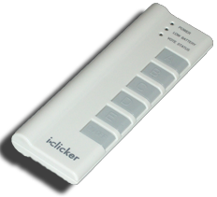
What do YOU think?
Which factor below is the most important in choosing the algorithm to use?
Simplest?
Easiest to implement?
Takes less time?
Uses up less space (memory)?
Gives a more precise answer?

Slide 7
Algorithm Analysis

Slide 8

Algorithm Analysis: Running Time
One commonly used criterion in algorithm analysis is running time
how long does the algorithm take to run and finish its task?
How do we measure it?
08:23:12

Slide 9
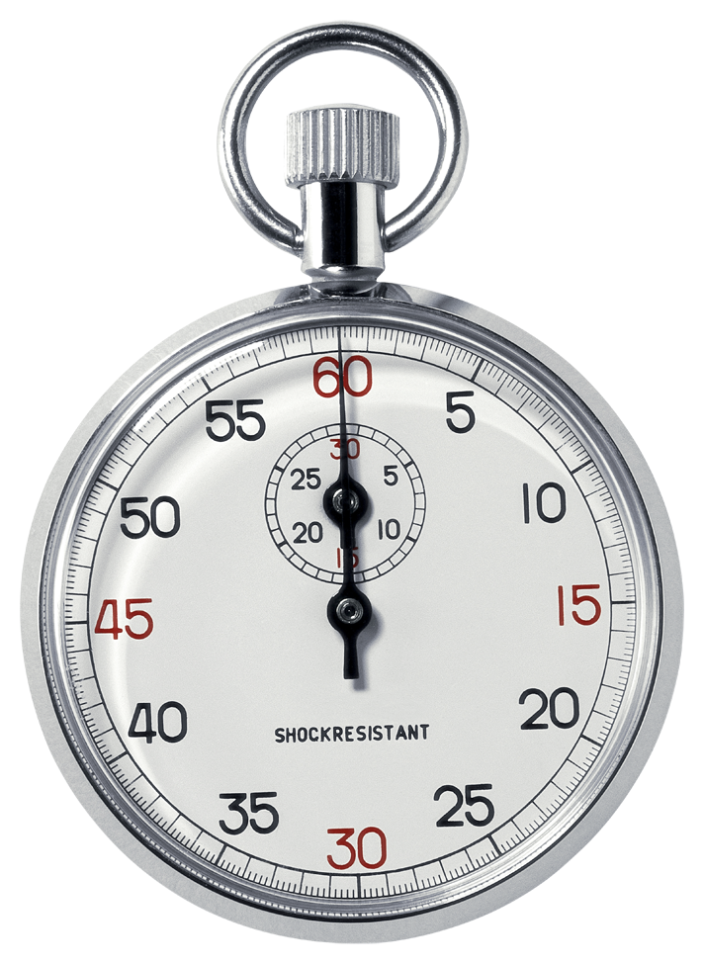
Runtime Analysis: Problem and Solution
Time with stopwatch, but…
Different computers may have different runtimes. ☹
Same computer may have different runtimes on same input. ☹
Need to implement the algorithm first to run it. ☹
Solution: Count the #of “steps” involved, not time!
Each operation = 1 step
If we say “running time”, we mean # of steps, not time!

Slide 10
Runtime Analysis: Input Size & Efficiency
Given # of input things
E.g., # of list elements
E.g., # of sentence characters
We define efficiency as a function of the input size
Running time (# of steps)
Memory Usage
We determine efficiency by reasoning formally or mathematically
Remember!
In CS10 we won’t care about the efficiency of your solutions!
Usually they care in CS61B
CS10
CS61A
CS61B
CS61C

Slide 11
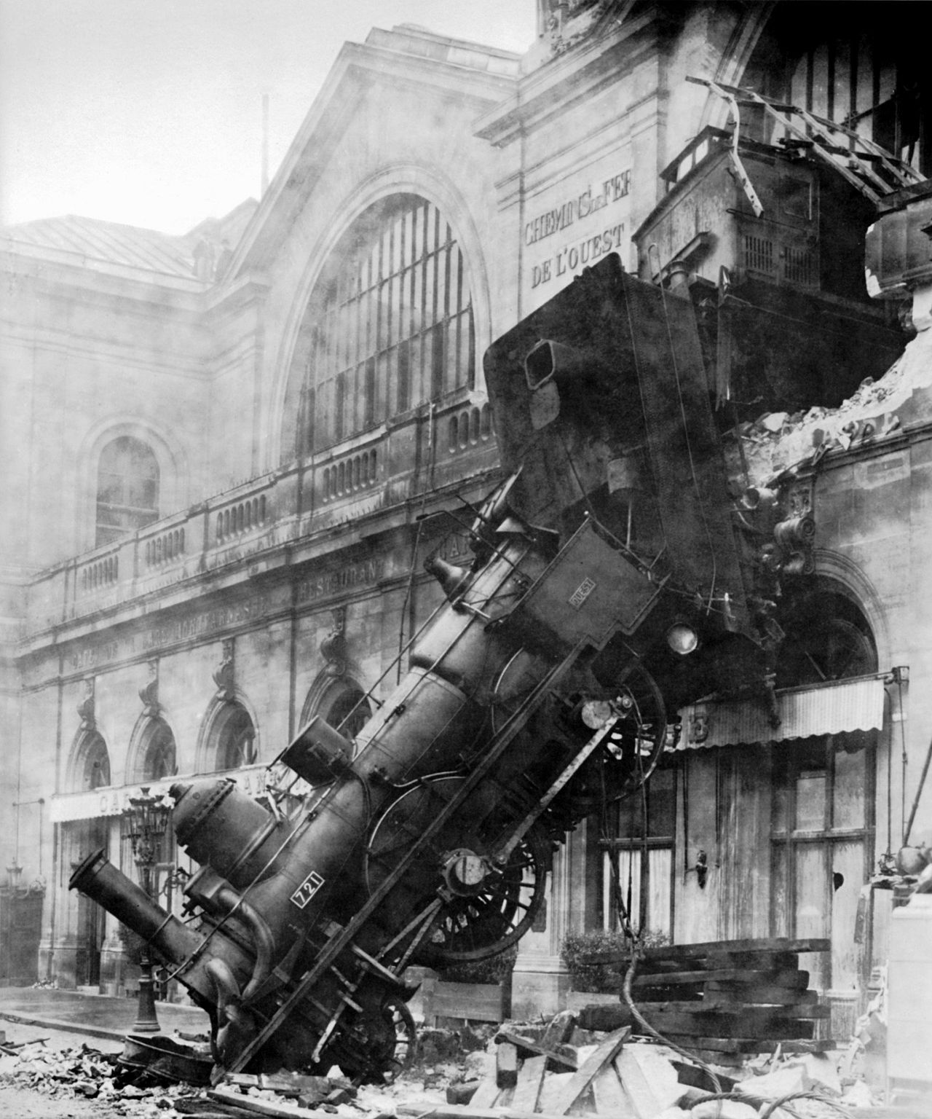
Runtime Analysis: Worst Case Scenario
Use worst case
Consider running time as input grows towards infinity
Why?
Nice to know most time we’d ever spend
Worst case happens more often than you think
Montparnasse Derailment (Wikipedia, Public Domain)

Slide 12
Runtime Analysis: Order of Growth
Instead of an exact number of operations we’ll use abstraction!
Want order of growth. As n grows larger and larger, dominant term will eclipse the other terms.
In CS10 we’ll consider
Constant
Logarithmic
Linear
Quadratic
Cubic
Exponential
E.g. 10 n² + 4 log n + n
…is quadratic
Exponential
Cubic
Quadratic
Linear
Logarithmic
Constant
Graph of order of growth curves on log-log plot
☑

Slide 13
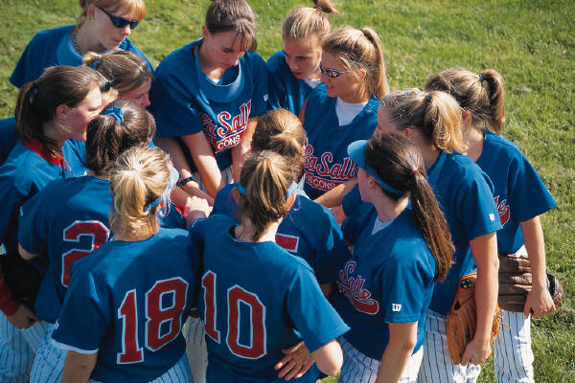
Example: Finding a student (by ID)
Input
Unsorted list of students L
Particular student S
Output
True if S is in L, else False
Pseudocode Algorithm
Go through one by one, checking for match.
If match, true
If exhausted L and didn’t find S, false
Worst-case running time as function of the size of L?
Constant
Logarithmic
Linear
Quadratic
Exponential

Slide 14
Example: Finding a student (by ID)
Input
Sorted list of students L
Particular student S
Output : same
Pseudocode Algorithm
Start in middle
If match, report true
If exhausted, throw away half of L and check again in the middle of remaining part of L
If nobody left, report false
Worst-case running time as function of the size of L?
Constant
Logarithmic
Linear
Quadratic
Exponential

Slide 15
Example: Finding a student (by ID)
What if L were given to you in advance and you had infinite storage?
Could you do any better than logarithmic?
Worst-case running time as function of the size of L?
Constant
Logarithmic
Linear
Quadratic
Exponential

Slide 16
Example: Finding a Shared Birthday
Input
Unsorted list L (of size n) of birthdays of team
Output
True if any two people shared birthday, else False
What’s the worst-case running time?
Worst-case running time as function of the size of L?
Constant
Logarithmic
Linear
Quadratic
Exponential

Slide 17
Example: Finding Subsets
Input:
Unsorted list L (of size n) of people
Output
All the subsets
Worst-case running time? (as function of n)
E.g., for 3 people (a,b,c):
1 empty: { }
3 1-person: {a, b, c}
3 2-person: {ab, bc, ac}
1 3-person: {abc}
Worst-case running time as function of the size of L?
Constant
Logarithmic
Linear
Quadratic
Exponential

Slide 18
Algorithms: Correctness, Summary

Slide 19
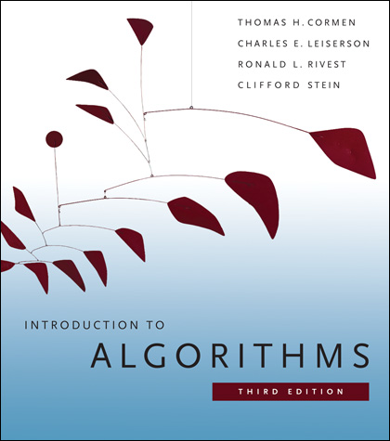
Reference Text for Algorithms
This book launched a generation of CS students into Algorithm Analysis
It’s on everyone’s shelf
It might be hard to grok at this point, but if you go on in CS, remember it & own it!
…but get the most recent edition

Slide 20
Algorithm Analysis: Is an Algorithm Correct?
An algorithm is correct if, for every input, it reports the correct output and doesn’t run forever or cause an error.
Incorrect algorithms may run forever, or may crash, or may not return the correct answer.
They could still be useful!
Consider an approximation…
For now, we’ll only consider correct algorithms
Euclid’s GCD Algorithm (Wikimedia)

